Slide 1
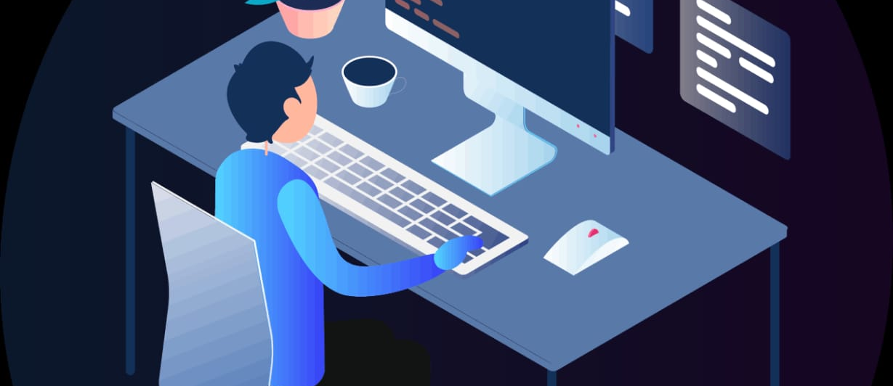
Project scheduling assistant
Shreya S K -3BR22EC157
D Ananya- 3BR22EC031
N Taruni – 3BR22EC104
Somshekar – 3BR22EC160

Slide 2
AGENDA:
1.Introduction
2.Hardware and Software used
3. Modules
4.Abstraction
5.Flowchart
6.Code
7.Output
8.Code Explaination
9.Conclusion

Slide 3

INTRODUCTION:
Efficient project management often requires meticulous scheduling and organization of tasks.
In software development, engineering projects, or any endeavor with multiple moving parts, keeping track of schedules, timelines, and deadlines is crucial for success.
To facilitate this process, Python offers a versatile platform for building robust project scheduling systems.
It leverages encapsulation, inheritance, and modular design to create a flexible framework for managing project timelines and schedules.

Slide 4
HARDWARE AND SOFTWARE:
Hardware:
Input Devices: Input devices such as a keyboard and mouse (or trackpad) are necessary for interacting with your development environment and software.
Internet Connection: While not strictly required for development, an internet connection can be useful for accessing documentation, libraries, and resources online.
Software:
Python Interpreter: Install Python, which is the core programming language for your project.
Integrated Development Environment (IDE): Choose an IDE for writing and managing your Python code. Popular options include PyCharm, Visual Studio Code
Project Management Libraries: Depending on the complexity of your project, you may need to install additional Python libraries for project management tasks

Slide 5
MODULES:
timeline.py: This module will contain the TimelineItem class, which represents a generic timeline item
schedule.py: This module will contain the Schedule class, which represents a scheduled task or event within a project.
project_timeline.py: This module will contain the ProjectTimeline class, which represents the timeline for a specific project.
project_scheduler.py: This module will contain the ProjectScheduler class, which manages project timelines and schedules.
main.py: This module will contain the main execution block and serve as the entry point of the program.

Slide 6
ABSTRACTION:
Schedule Class:
Attributes:
Schedule_Id: Unique identifier for the schedule.
Start_date: Start date of the schedule.
end_date: End date of the schedule.
Methods:
update(start_date, end_date): Update the start and end dates of the schedule.
ProjectTimeline Class:
Attributes:
project_name: Name of the project.
end_date: End date of the project timeline.
schedules: List to store schedules associated with the project timeline.
Methods:
add_schedule(schedule): Add a schedule to the project timeline.
remove_schedule(schedule_id): Remove a schedule from the project timeline.
update_schedule(schedule_id, start_date, end_date): Update the start and end dates of a schedule in the project timeline.

Slide 7
ProjectScheduler Class:
Attributes:
timelines: Dictionary to store project timelines with project names as keys.
Methods:
create_timeline(project_name, end_date): Create a new project timeline.
adjust_schedule(project_name, schedule_id, start_date, end_date): Adjust the dates of a schedule in a project timeline.
delete_timeline(project_name): Delete a project timeline.
display_schedule(project_name): Display the schedules of a project timeline.
get_current_date(): Get the current date.

Slide 8
Algorithm:
Class Definitions:
Define three classes: TimelineItem, Schedule, and ProjectTimeline.
TimelineItem represents a generic time interval with start and end dates.
ProjectTimeline represents the timeline of a project and contains schedules.
ProjectScheduler Class:
Manages project timelines through methods for creating, adjusting, deleting, and displaying timelines.
Validates input dates and ensures the project's readiness before creating timelines.
Main Program:
Create a ProjectScheduler instance.
Run a loop to interactively choose operations.
Input Handling:
For each operation, prompt the user for input such as project name, schedule ID, start date, and end date.
Validate inputs and execute corresponding methods in the ProjectScheduler class.
Output Handling:
Provide feedback messages for successful or failed operations.
Display schedules with their IDs, start dates, and end dates.
Current Date Simulation:
Simulate the current date for validation purposes.
Exit Condition:
Exit the loop and end the program upon selecting the exit option.

Slide 9
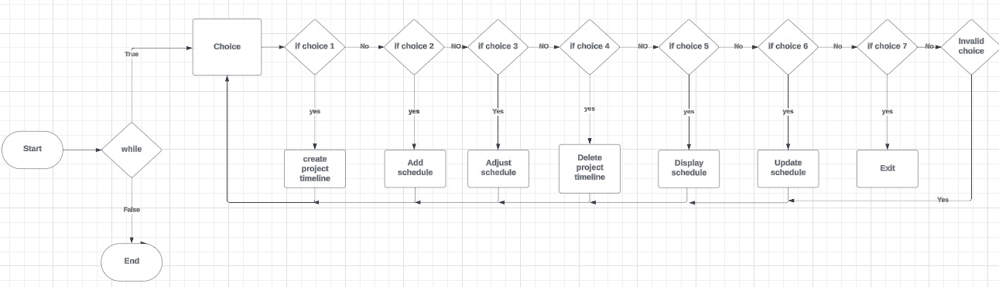
FLOWCART

Slide 10
Output:
Enter end date (YYYY-MM-DD): 2024-06-17
Schedule added.
1. Create Project Timeline
2. Add Schedule
3. Adjust Schedule
4. Delete Project Timeline
5. Display Schedule
6. Update Schedule
7. Exit
Enter your choice: 3
Enter project name: project A
Enter schedule ID: 1234
Enter new start date (YYYY-MM-DD): 2024-06-18
Enter new end date (YYYY-MM-DD): 2024-07-08
end date extended
Schedule adjusted.
1. Create Project Timeline
2. Add Schedule
3. Adjust Schedule
4. Delete Project Timeline
5. Display Schedule
6. Update Schedule
7. Exit
1. Create Project Timeline
2. Add Schedule
3. Adjust Schedule
4. Delete Project Timeline
5. Display Schedule
6. Update Schedule
7. Exit
Enter your choice: 1
Enter project name: project A
enter end date(YYY-MM-DD):2024-04-29
timeline created
1. Create Project Timeline
2. Add Schedule
3. Adjust Schedule
4. Delete Project Timeline
5. Display Schedule
6. Update Schedule
7. Exit
Enter your choice: 2
Enter project name: project A
Enter schedule ID: 1234
Enter start date (YYYY-MM-DD): 2024-05-09

Slide 11
Enter your choice: 5
Enter project name: project A
Schedule ID: 1234, Start Date: 2024-06-18, End Date: 2024-07-08
1. Create Project Timeline
2. Add Schedule
3. Adjust Schedule
4. Delete Project Timeline
5. Display Schedule
6. Update Schedule
7. Exit
Enter your choice: 6
Enter project name: project A
Enter schedule ID: 1234
Enter new start date (YYYY-MM-DD): 2024-05-08
Enter new end date (YYYY-MM-DD): 2024-06-18
Schedule updated.
1. Create Project Timeline
2. Add Schedule
3. Adjust Schedule
4. Delete Project Timeline
5. Display Schedule
6. Update Schedule
7. Exit
Enter your choice: 7
Exiting...

Slide 12
EXPLANATION:
TimelineItem Class: This class represents a generic timeline item with a start date and an end date. It has methods to retrieve these dates.
Schedule Class (Inherits from TimelineItem): This class represents a schedule item. It inherits from TimelineItem and adds a schedule ID attribute. It also has a method to update the schedule with new start and end dates.
ProjectTimeline Class: This class represents a timeline for a project. It contains a list of schedules for the project. It has methods to add, remove, and update schedules within the project timeline.
ProjectScheduler Class: This class manages project timelines. It contains a dictionary (timelines) that stores project timelines indexed by project names. It has methods to create, adjust, and delete project timelines. It also has a method to display schedules within a project timeline.
Main Execution Block: In the main block, an instance of ProjectScheduler is created. A menu-driven interface allows users to perform various operations such as creating project timelines, adding schedules, adjusting schedules, deleting timelines, displaying schedules, updating schedules, and exiting the program.
Overall, this code provides a basic framework for managing project timelines and schedules, allowing users to interactively perform operations on project schedules through the console interface.

Slide 13
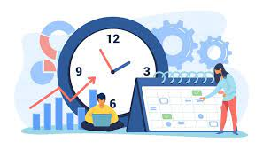
CONCLUSION:
The project scheduling assistant provides essential functionalities for managing project timelines and schedules through a command-line interface.
It ensures data validation, offers informative feedback to users, and can be extended for more complex scheduling needs.
With its simplicity and flexibility, it serves as a solid foundation for efficient project management.

Slide 14


